Slide 1

AI Deep Research Models
Namig Abbasov
Data Science and Analytics

Slide 2

What is AI Deep Research?
goes beyond basic Q&A to autonomously gather info
search, read, and analyze many online sources
web pages, PDFs, and images
all in response to a single user prompt
synthesize knowledge from these sources
takes much longer than standard models

Slide 3
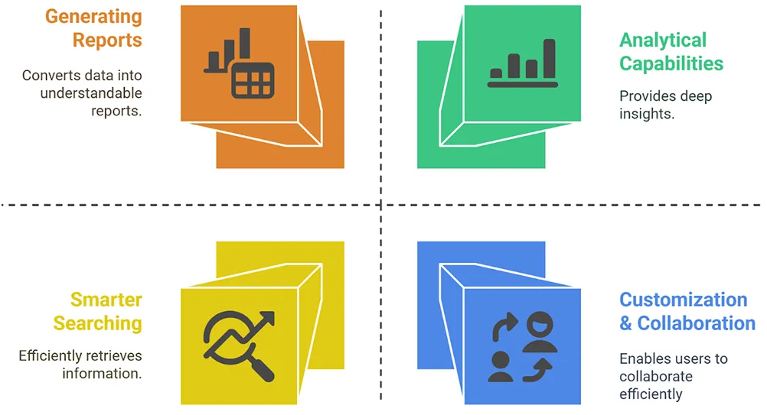
Capabilities of Deep Research Models
Vina 2025

Slide 4

AI Tools for Deep Research
Grok 3 Deep Research
OpenAI Deep Research
Perplexity Deep Research
Google Gemini Deep Research
DeepSeek’s DeepThink
Microsoft Copilot’s Think Deeper
Notes:
https://www.instituteofaistudies.com/insights/5-use-cases-for-chatgpt-deep-research

Slide 5

OpenAI’s Deep Research
AI agent powered by a version of o3 model
Designed to browse web and analyze multiple sources
Synthesize large amounts of information.
Has great potential but but also produces incorrect info and inferences

Slide 6
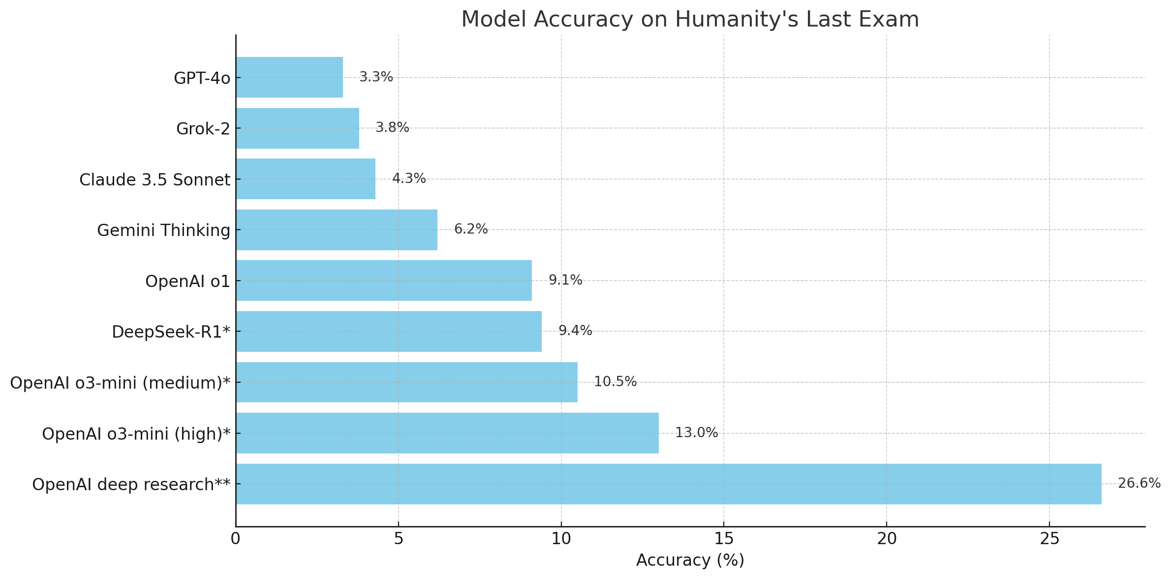
Open AI Deep Research Performance: HLE
Source: Plotted based on online OpenAI data

Slide 7
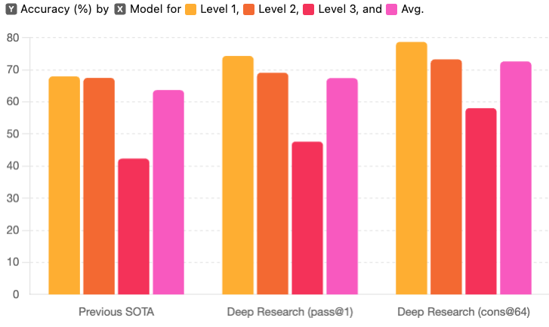
Open AI Deep Research Performance: GAIA

Slide 8
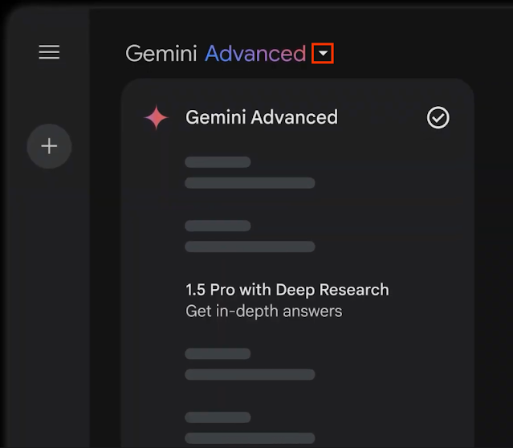
Google’s Gemini Deep Research Model
Introduced in Feb 2025 for users with access to Gemini Advanced
Updated in May 2025
Use with 2.5 Flash Experimental
Upload PDFs and links from Google Drive
Use Cases from Its Website:
Industry research
Competitive research
Customer research
Educational research

Slide 9
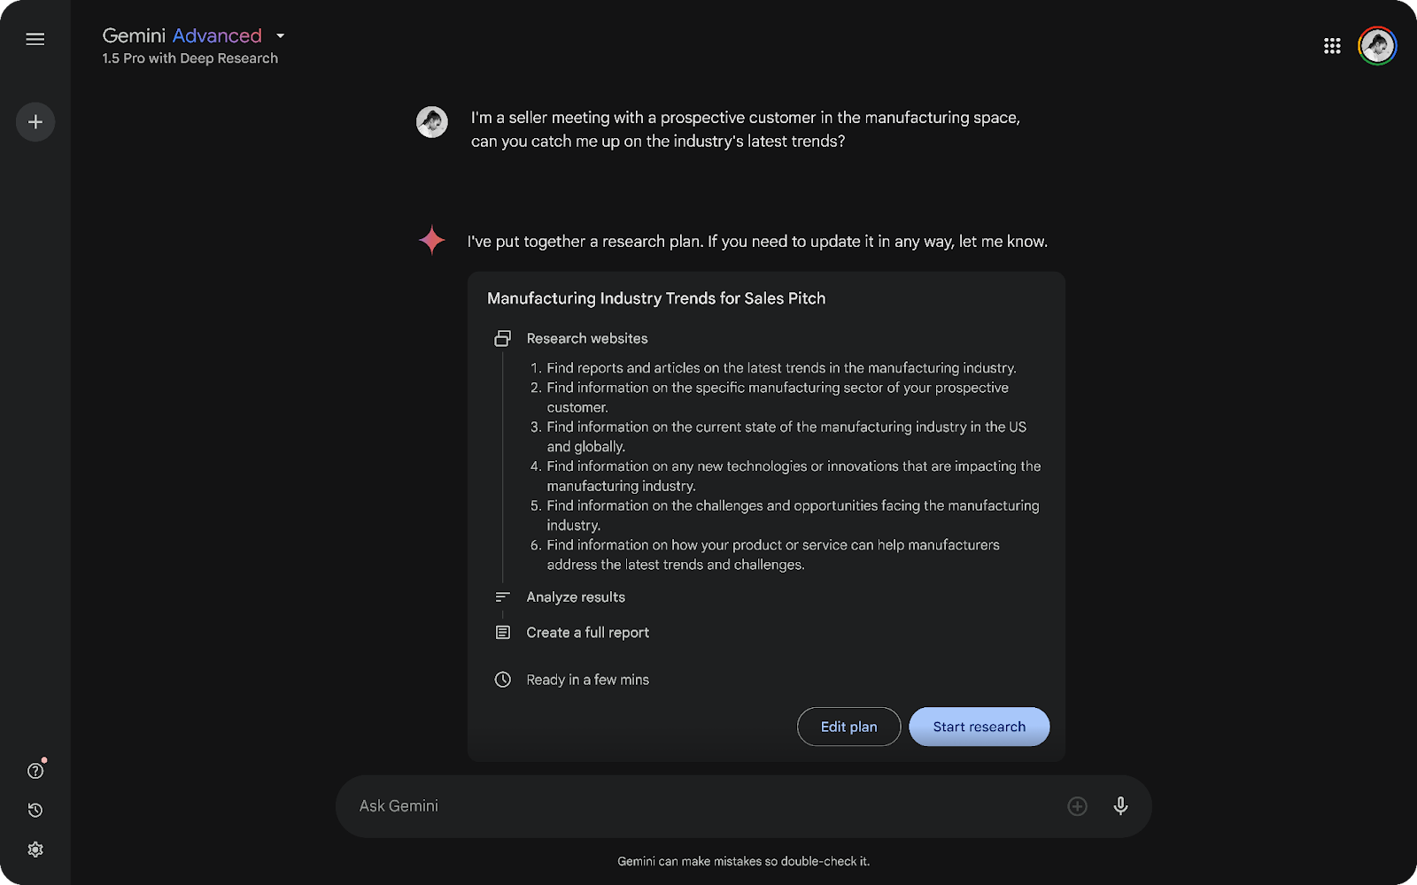
This Video Show Step-By-Step Process of Using Gemini Deep Research Model

Slide 10
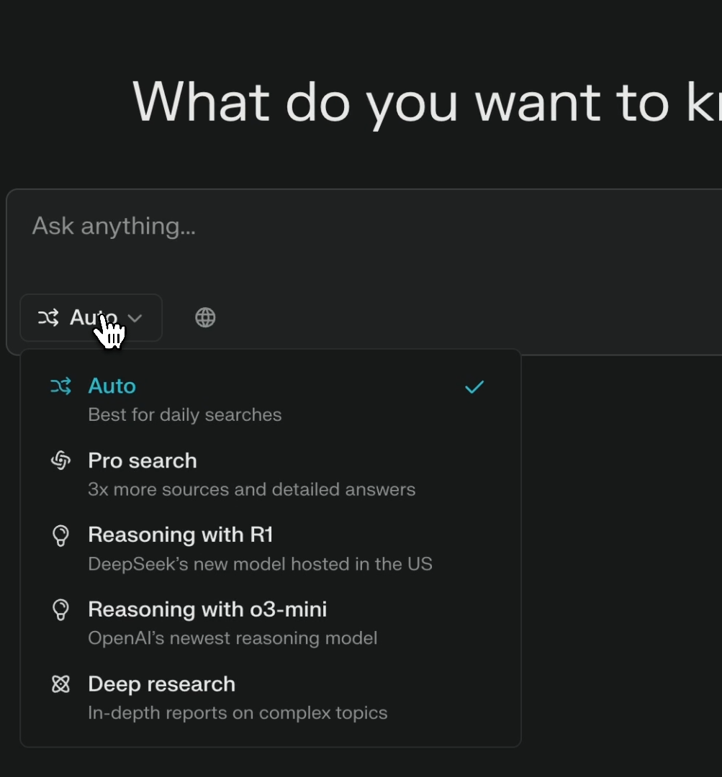
Perplexity’s Deep Research Model
Some Uses Cases
Enhanced Web Searching
Deep Research and Information Gathering
Market Research
Fact-Checking and Source Verification
Financial Analysis and Reporting

Slide 11
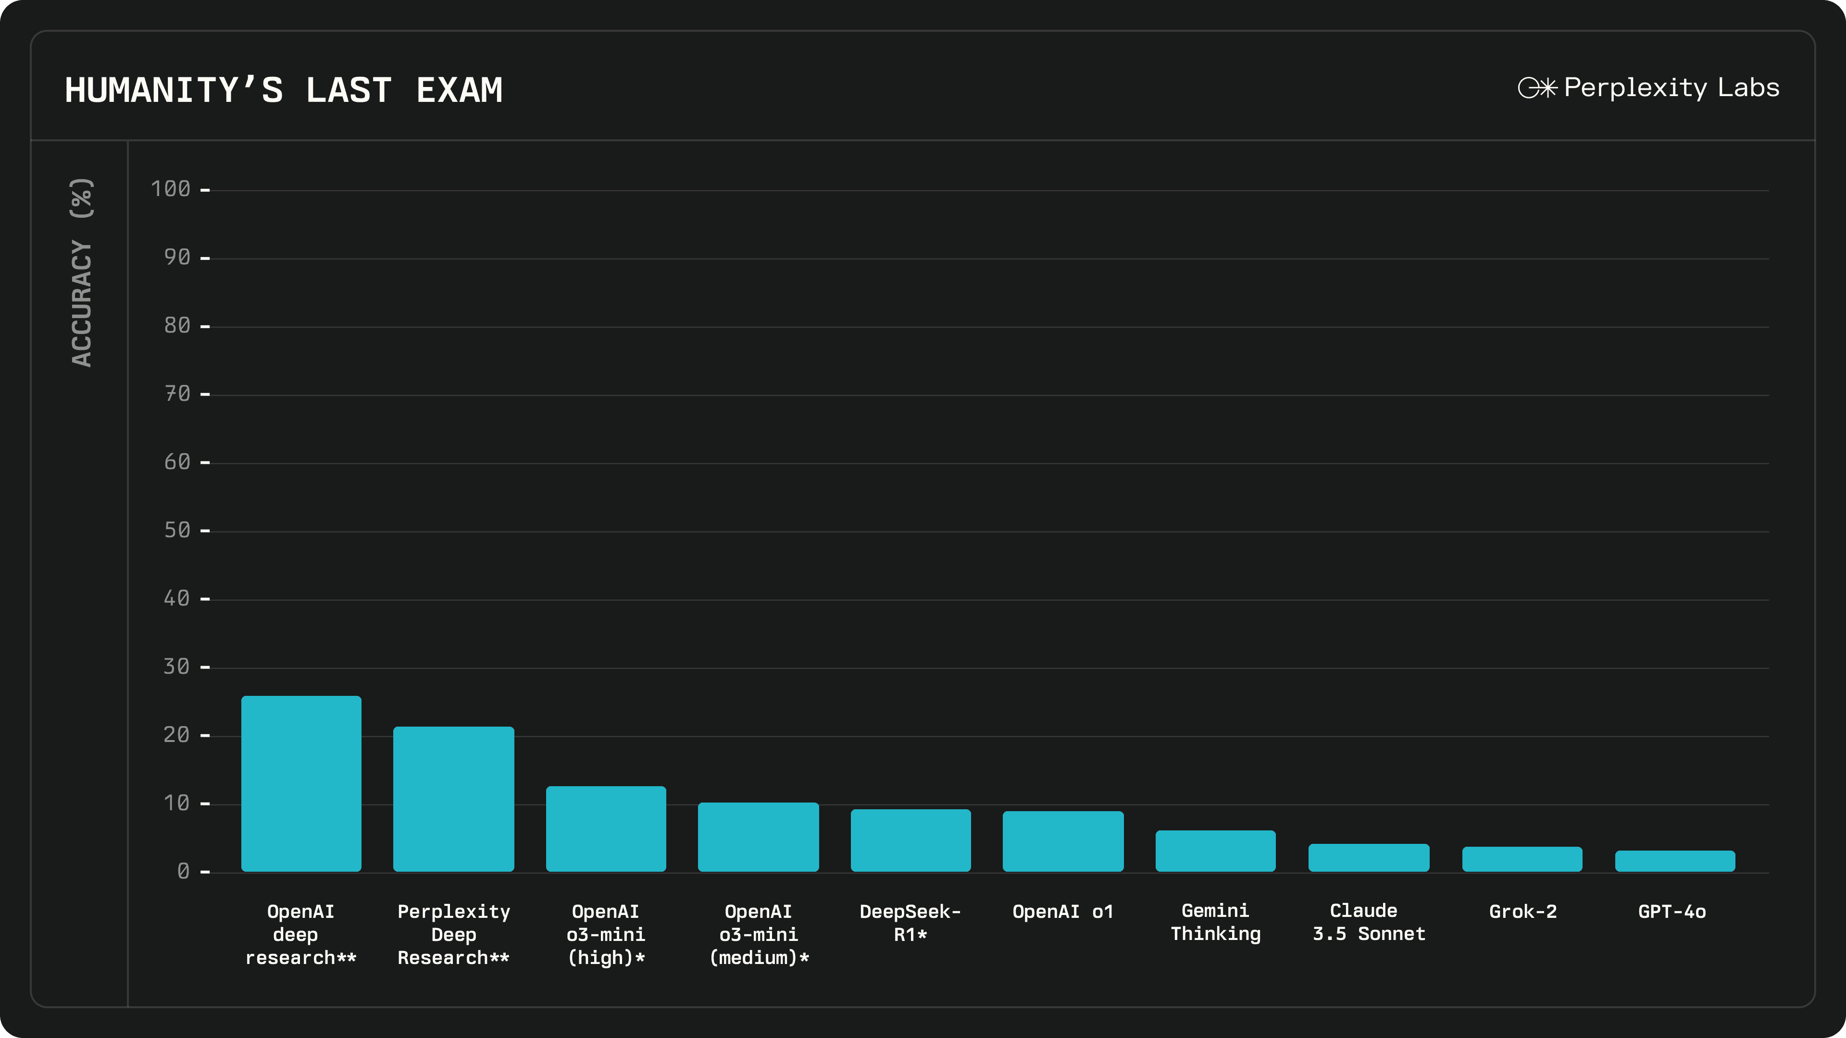

Slide 12
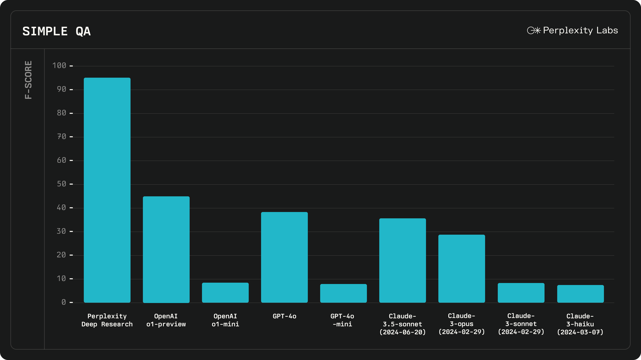

Slide 13
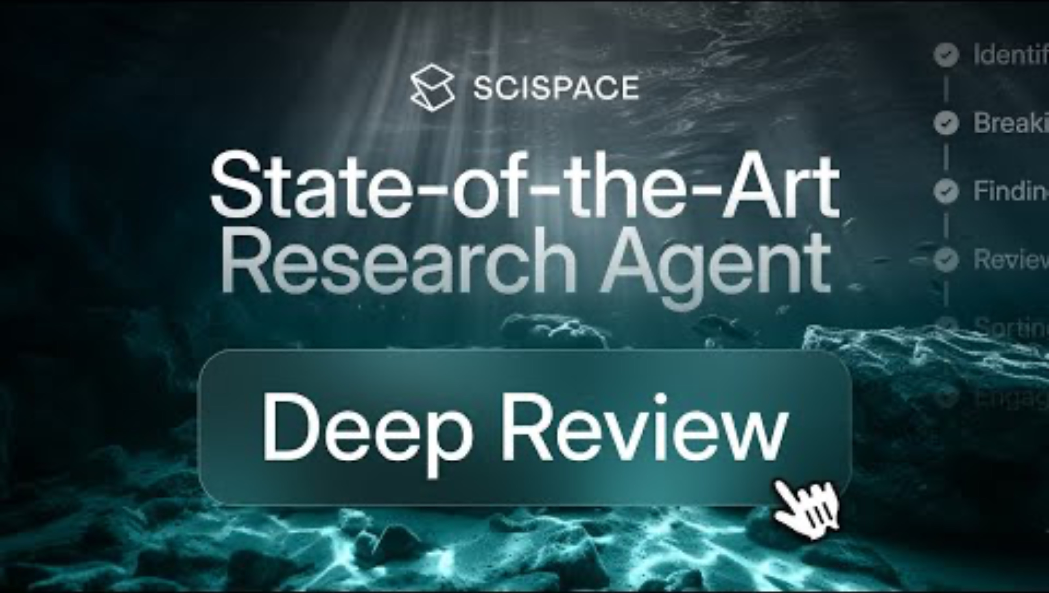
Scispace: “Fastest Research Platform”
Access Deep Review
Generate Deep Literature Analysis
Interact with the Analysis
Customize and Refine

Slide 14
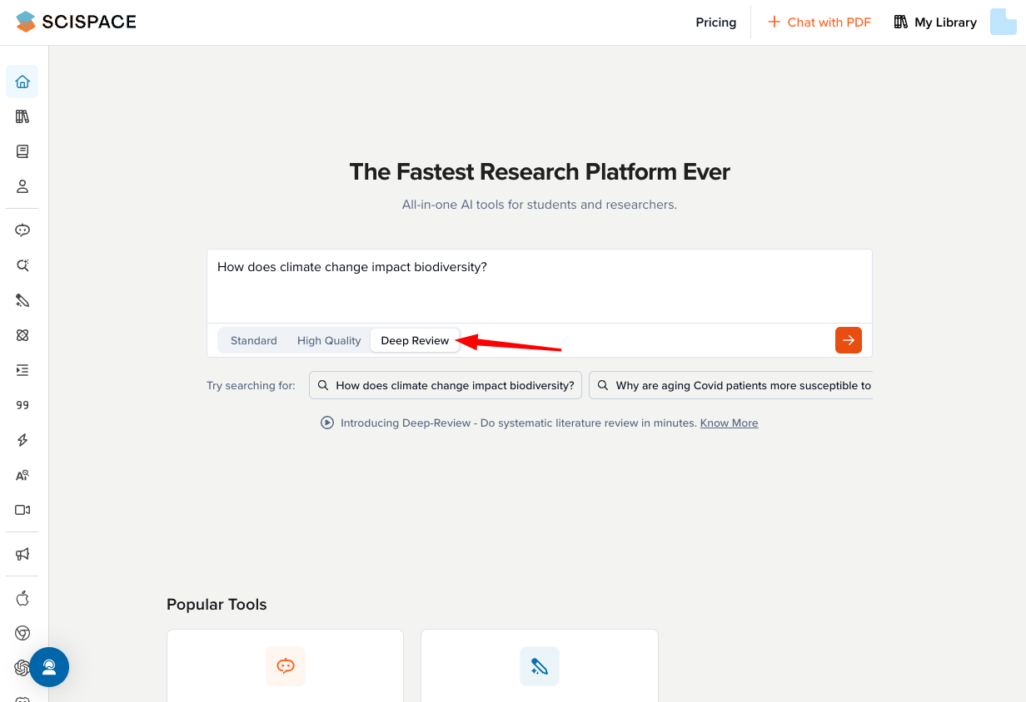
Scispace: “Fastest Research Platform Ever”

Slide 15
Using Scispace Deep Preview
Below are suggestions by its developers
But important to have full control over research process
Best Use Cases
Conducting comprehensive literature review for thesis or dissertation.
Identifying emerging trends or research gaps in a field.
Quickly gathering multiple perspectives on a complex research question.
Preparing a foundation of background reading for a research proposal.
Best Practices
Start with a clear and focused research question.
Use follow-up queries with Copilot to clarify or go deeper.
Save important insights to your Notebook for quick reference.
Combine Deep Review with Chat with PDF and Literature Review for a full research workflow.

Slide 16
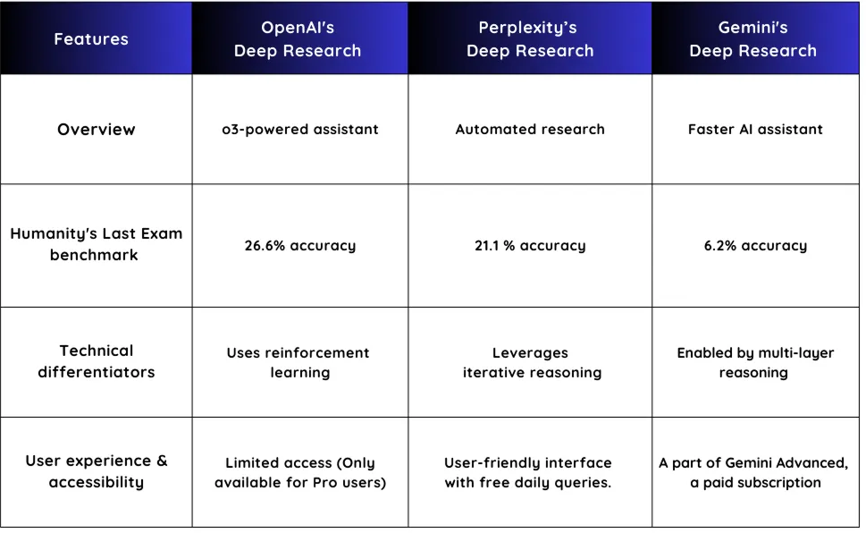
Deep Research Models in Comparison
Vina 2025

Slide 17
Important Considerations
Transformer-based models, while powerful, can produce inaccurate or misleading content. References may be fabricated or incorrectly cited, and the generated text often combines ideas without logical coherence. These models may also create feedback loops that steer users in unproductive or misleading directions.
Critically, expert-level knowledge is essential to assess the validity and usefulness of their outputs. Users must evaluate whether any part of the generated content holds real value. While these models can act as capable assistants, their utility hinges on the user’s ability to maintain full control over the content they produce.

Slide 18
Hands-on with OpenAI’s Deep Research: Investigating the Impact of Climate Change on Crop Yields in Sub-Saharan Africa
We will use the prompt below:
You are a scientific research assistant helping with an in-depth literature review. Your task is to investigate the relationship between climate change and agricultural crop yields in Sub-Saharan Africa.
Objective: Provide a comprehensive analysis answering the following questions:
What are the major climate variables (e.g., temperature, rainfall) affecting crop yields in this region?
Which crops (e.g., maize, millet, sorghum) are most impacted, and how?
What methodologies are typically used to assess this impact (e.g., empirical studies, crop simulation models, machine learning)?
What are the most cited studies in the past five years on this topic?
What adaptation strategies have been proposed and how effective are they?
Instructions:
Conduct deep literature review.
Synthesize key findings from multiple sources.
Present output in structured report with headers, bullet points, citations, and a brief conclusion.
Clearly separate evidence-based findings from commentary or interpretation.
Ensure scientific tone and accuracy.

